Slide 1


Building a Personalized Online Course Recommender System with Machine Learning
Kameron Scott
Oct. 15, 2024

Slide 2

Outline
Introduction and Background
Exploratory Data Analysis
Content-based Recommender System using Unsupervised Learning
Collaborative-filtering based Recommender System using Supervised learning
Conclusions

Slide 3
Introduction
Recommender systems provide a powerful way to:
Enhance the user experience by making them aware of additional content/products relevant to their interests
Increase user engagement with content/products
Gain insights into user interactions with provided content/products
In this presentation, I overview methods used to develop recommender systems for an online learning platform

Slide 4
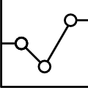
Exploratory Data Analysis

Slide 5
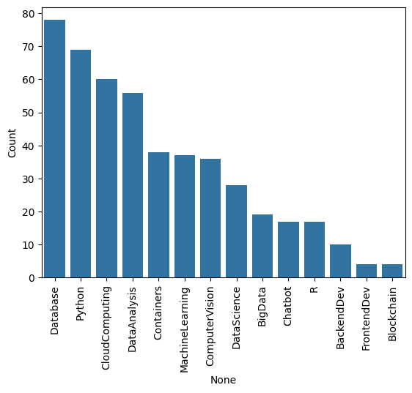
Course counts per genre
Notes:
This bar chart shows the total counts of each genre across all courses within the database used for developing the recommender systems.

Slide 6
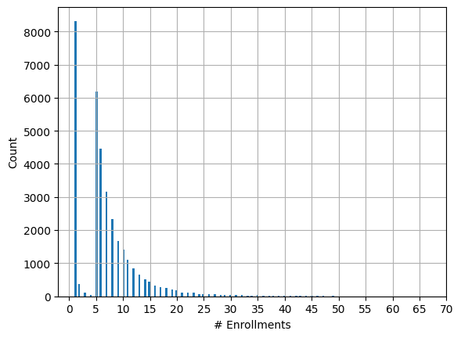
Course enrollment distribution
Notes:
This historgram shows the number of users that are enrolled in various quantities of courses.
For example, we can see that around 8200 users are enrolled in just one course, while fewer than 1000 are enrolled in 12 courses.

Slide 7
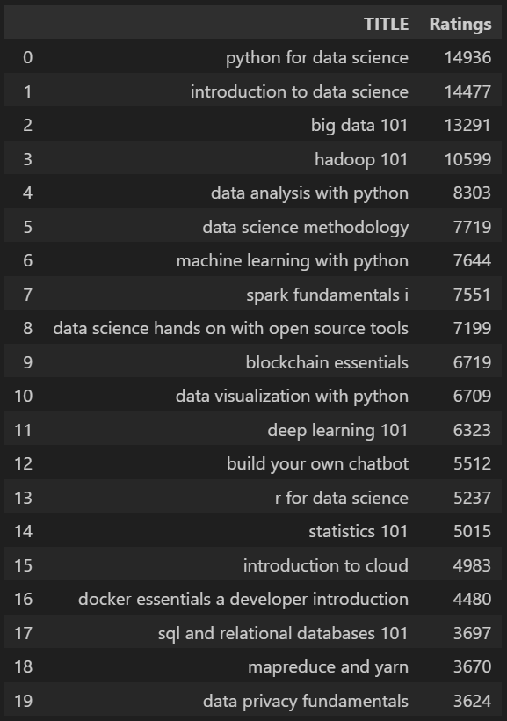
20 most popular courses
Notes:
The table above contains the top 20 most popular courses in the dataset in descending order.
We can see topics related to data science and big data are by far the most popular.

Slide 8
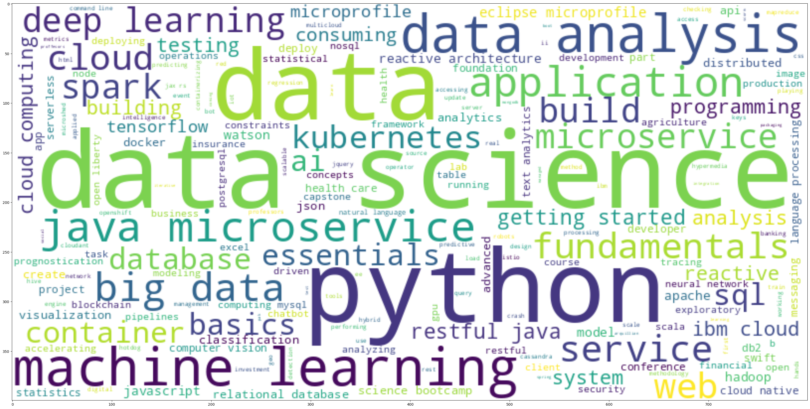
Word cloud of course titles
Notes:
This word cloud illustrates the relative popularities of various course genres.
Courses related to data science and python are largest, because they are among the most popular
While smaller words (e.g. excel and css) are considered less popular.

Slide 9
Content-based Recommender System using Unsupervised Learning
Cluster2
Cluster1

Slide 10
Flowchart of content-based recommender system using user profile and course genres
Course 1 Genre Vector
Course 1 score
Profile Vector
Dot Product
Course 2 Genre Vector
Course 2 score
>= Score Threshold
Recommendations List
Course 3 Genre Vector
Course 3 score
Etc.
Notes:
Beginning with the User Profile Vector, it is a collection of values representing interaction level with different course topics.
The user profile vector is dotted (mixed) with all course genre vectors for courses the user has not taken.
The course genre vector is similar to the user profile vector, but it represents the inclusion and exclusion of different topics in each course.
The dot product gives us a score for each course, and if those scores exceed the threshold value (specified by us), then that course is added to the final recommendations list.

Slide 11
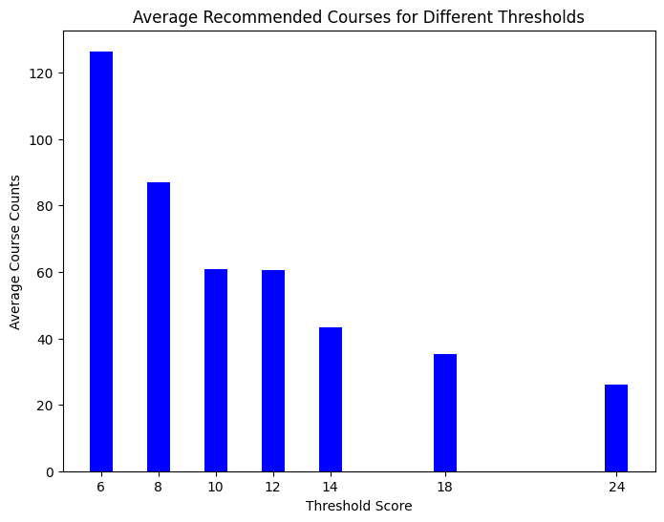
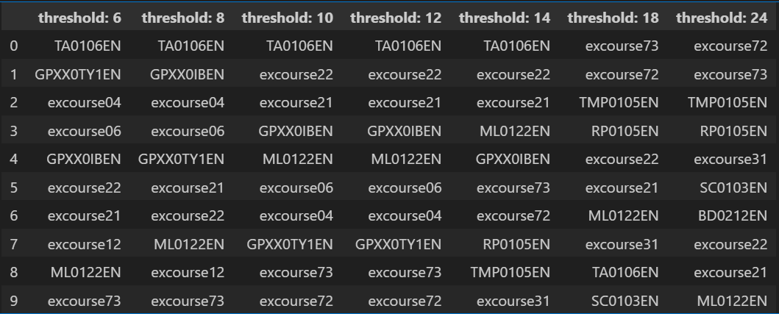
Evaluation results of user profile-based recommender system
Our only hyper parameter to adjust for this model is the threshold score.
I have provided a range of values for the threshold score
Notes:
Collect the data required for these two plots for 3-5 different score thresholds (e.g. range from 6-12, incremented by 2)

Slide 12
Flowchart of content-based recommender system using course similarity
User Courses
Course Similarity Matrix
>= Similarity Threshold
Recommendation list
Unenrolled Courses
All Course Genre Vectors
Similarity Calculations
Notes:
Prior to generating recommendations, we take the courses genre vectors for every course in the system and create a course similarity matrix.
This Matrix can be created using a variety of similarity metrics (cosine, jaccard, etc.).
The list of courses each user has interacted with is (or is enrolled in) is taken alongside the list of all courses the user has NOT interacted with.
Using the course IDs for each, we can find the precalculated course similarity value within the matrix.
If that value is at least the predefined similarity threshold value, we can add the unenrolled course to the recommendation list.
Once all the unenrolled courses have been measured against the user’s enrolled courses, we have a complete recommended courses list available for the user.

Slide 13
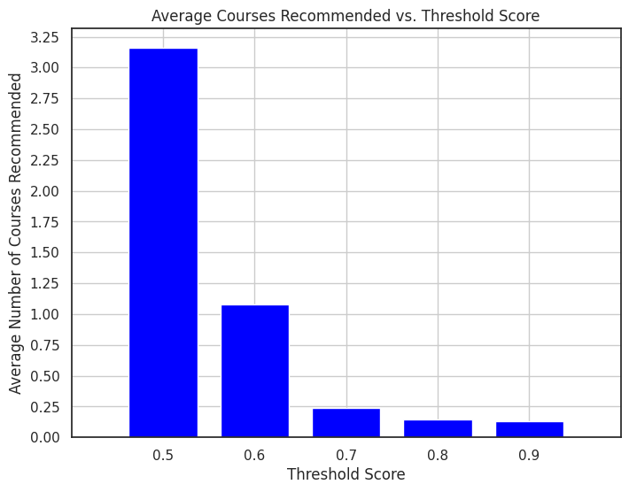
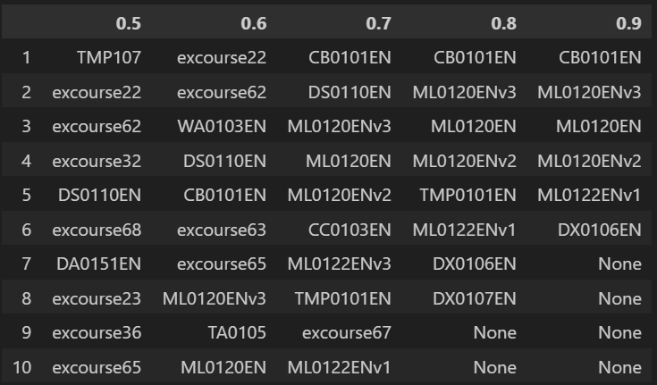
Evaluation results of course similarity based recommender system
For this recommender system, we have a single hyper-parameter we can adjust.
Below is a few sample output statistics with a range of threshold values.
Notes:
Compared to the previous recommender system using user profiles, we see a significant drop in the number of courses recommended.
For higher threshold values, we can even see that very few courses from the complete collection of courses are being recommended across all 33,000+ users.

Slide 14
Flowchart of clustering-based recommender system
Dimensionality Reduction (PCA)
Reduced Profile Vectors
K-Means Clustering
User Clusters
User Profile Vectors
Determine User Cluster
Fetch Enrolled Courses Counts for Cluster
Determine Unenrolled Courses for User
Unseen Courses for User
User Enrolled Courses
Cluster Enrollment Count >= popularity threshold
Recommended Course List
Notes:
Firstly, we begin with the list of all User Profile Vectors and perform PCA to reduce the dimensionality as much as possible (we try to keep a certain significant percentage of the explained variance with the resulting features).
With the reduced feature vectors for each user, we perform K-means clustering to group the users into clusters of similar users.
These new clusters can be used to find users with similar course enrollments, and use the enrolled courses within the entire cluster as a pool for recommending them to other users within the cluster.
For each user, we determine the cluster they’re in, then fetch all the enrolled courses within that cluster, as well as the count for each time each course appears.
We can subtract the larger list from the smaller to determine the courses the user in question is not yet enrolled in (unseen courses), but that the other users in their cluster are enrolled in.
We decide on an enrollment count threshold to identify “popular” courses within the cluster, and then recommend those to the user.

Slide 15
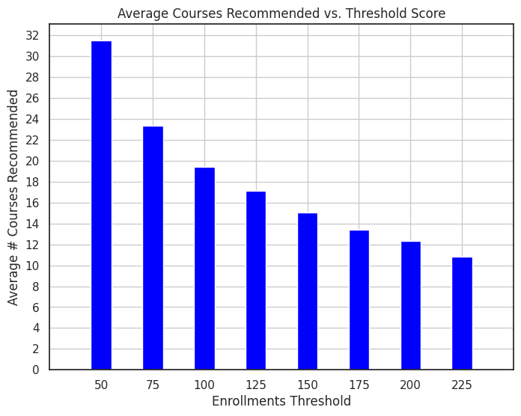
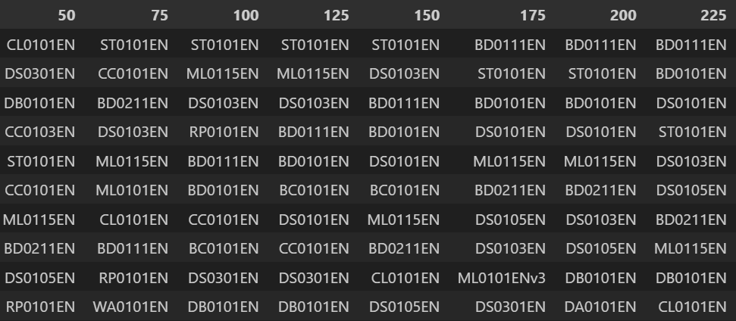
Evaluation results of clustering-based recommender system
Hyperparameters:
PCA components: 9
k-means clusters: 19
The enrollments threshold hyperparameter is varied in the plot and chart below

Slide 16
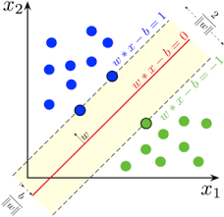
Collaborative-filtering Recommender System using Supervised Learning

Slide 17
Flowchart of KNN based recommender system
User-Item Interaction Matrix
User Similarity Vector
List of predicted interaction ratings
Recommended Courses List
Calculate Similarity b/w other Users
Predict ratings for unseen courses using k-nearest users
Filter out Courses Under a Rating Threshold
Notes:
We begin with a user-item interaction matrix, which contains interaction scores or ratings for each course that users have engaged with, where higher scores indicate stronger engagement or preference.
For each user, we calculate their similarity with all other users using a similarity metric (e.g., cosine similarity, Pearson correlation), producing a similarity vector between the target user and all others.
The KNN algorithm identifies the k most similar users to the target user based on these similarity scores. Using these k-nearest users, we predict interaction ratings for any courses that the target user hasn’t interacted with yet. These predictions are generated by weighting each neighbor’s ratings by their similarity score relative to the target user.
Finally, we can set a minimum rating threshold, filtering out any courses whose predicted ratings don’t meet or exceed this threshold. The remaining courses, which exceed the threshold, are then recommended to the user.

Slide 18
Flowchart of NMF based recommender system
User-Feature Matrix
User-Item Interaction Matrix
NMF
Reconstruct User-Item Matrix
Approximate User-Item Matrix
Feature-Item Matrix
Notes:
As usual, we begin with our user-item interaction matrix, which contains known rankings/preferences for every user and every course.
We apply non-negative matrix factorization to our matrix, and obtain two matrices containing our original users, our original items, and some latent features identified by the algorithm. These latent features encode relationships within our original matrix, and can be used to approximate the original user-item matrix.
This approximation is useful, because it tends to replace missing/zero entries with values based on the latent features, providing us with what is essentially an educated “guess” as to what those missing interaction values may be.
From this approximate reconstruction, we can then determine which (originally unseen) courses are likely to have a high interaction level, and thus courses we can recommend to the user.

Slide 19
Flowchart of Neural Network Embedding based recommender system
One-Hot User Vector
Embedding Layer
User Embedded Vector
Dot Product
ReLu Activation
Rating Estimation
One-Hot Item Vector
Embedding Layer
Item Embedded Vector
Notes:
From the user-item interaction matrix, we can one-hot encode the users and courses into vectors which identify uniquely each user and item.
With these one-hot encoded vectors, we pass them each through embedding layers, reducing the dimensionality of each into a latent feature space.
Once we have the embedded vectors for the user and item in question, we can simply take the dot product between them, pass the result through our activation function, and ultimately produce a rating estimation between a course and a user.

Slide 20
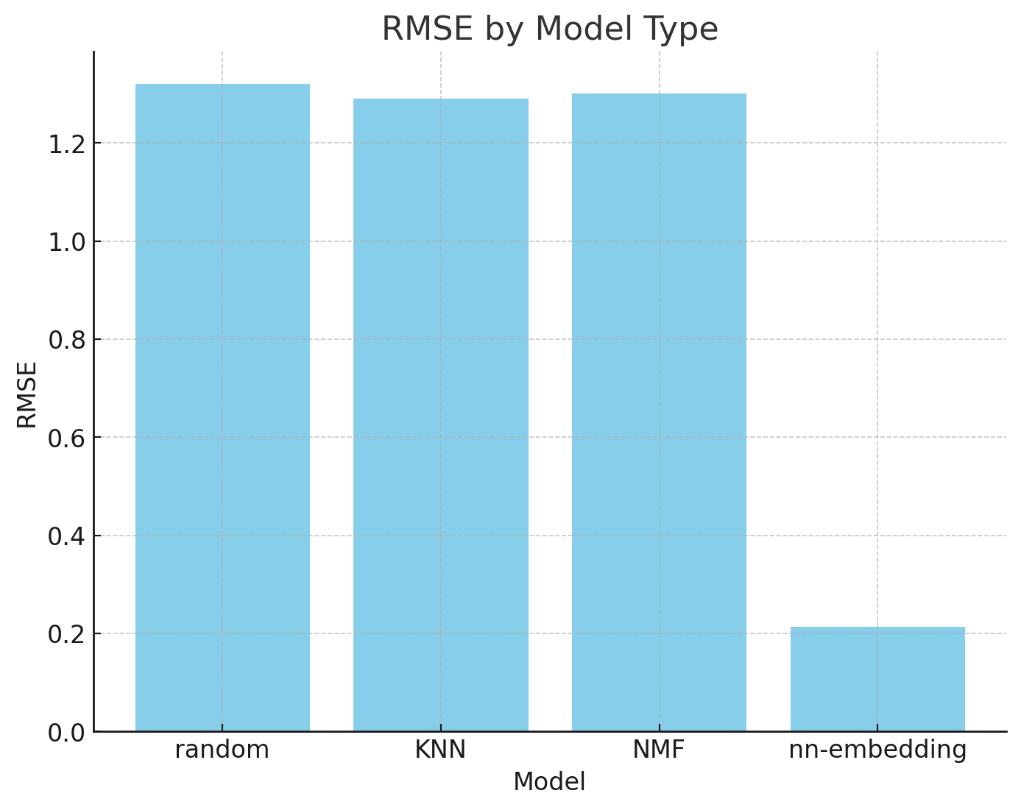
Compare the performance of collaborative-filtering models
Notes:
This bar chart showcases the collaborative models described in the 3 previous slides.
“Random” refers to randomly guessing the user’s rating.
As we can see, the KNN and NMF models only performed marginally better than randomly guessing, while the neural network embedding model had much better performance.
The KNN and NMF models could likely be improved through more thorough feature engineering.

Slide 21
Conclusions
The User Profile-based recommender system performed quite well, providing at least 40 course recommendations on average per user
The Course Similarity system worked rather poorly, only recommending 3 courses per user on average at a low threshold
The k-means clustering system performed adequately, giving each user about 10 recommendations on average, even with a high cluster enrollments threshold
The KNN and NMF models all but failed, only performing marginally better than randomly guessing the users rating
The Neural Network Embedding model performed rather well, reaching an rmse of 0.21 (compared to 1.3 for the other two models)
Notes:
For these bullet points, summarize the stats shown for each model (avg recommendations per user, distribution of courses recommended, etc.)

